Slide 1
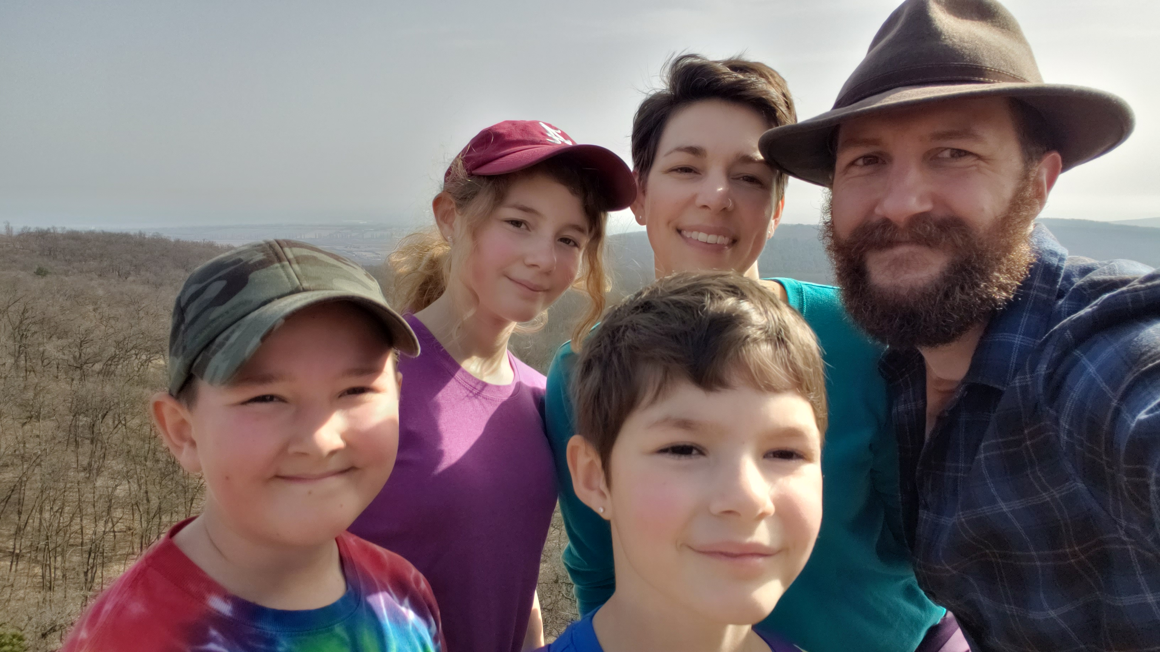
Go,
Kelleys,
Go!
Notes:
Good morning!
My name is David Kelley. My wife is Jenn, and we have three children: Annora, Allister, and Annalise.
We serve as missionaries
in Budapest, Hungary
at the International Christian School of Budapest.
Ministry is primarily to TCKs (third-culture kids define)
Over the past 10 years in Hungary, we have had the same 3 ministry goals:
Proclaim the Gospel to the lost.
Disciple those who are found.
Support others as they fulfill God’s call on their lives.

Slide 2
Celebration!
Seeing God in the Face of Challenge
Philippians 4: 4-9
Notes:
As we’ve reflected on the past 10 years, and all the highs and lows, we have had to process a lot of hardships and challenge, but we also see reason to celebrate.
Philippians is one of my favorite letters from Paul to study, and he has a lot to say about celebrating, and he certainly knew something about challenges.
Let’s look at what Paul has to say.

Slide 3
Context of Philippians
Challenge
Paul’s Chains (1:7, 12-14)
Philippians’ Persecution (1:29ff)
Christ’s Suffering (2:6-8)
Notes:
To understand what is happening here, we need to first recognize the context and theme of Philippians.
Philippians was written in the context of Challenge:
Paul is in prison
The Philippians are being persecuted and are in a state of poverty
Paul reminds the Philippians that they are not alone – Christ also suffered
Real challenges permeate the entire letter.

Slide 4
Theme of Philippians
Joy
Modeled (1:4, 18; 4:10)
Encouraged (2:17)
Commanded (3:1, 4:4)
Notes:
Remarkably, within this context of hardship, Paul explicitly mentions joy at least 13 times in the book.
There is an interesting progression of the way he talks about joy as we move through the letter:
First, he models what joy looks like in the face of suffering.
Then Paul alludes to the joy of Christ in the face of suffering.
Next, Paul encourages the Philippians to be joyful despite their suffering.
Finally, Paul commands the Philippians be joyful before circling back to his own example.

Slide 5
Philippians 4:4-9
⁴ Rejoice in the Lord always. I will say it again: Rejoice! ⁵ Let your gentleness be evident to all. The Lord is near. ⁶ Do not be anxious about anything, but in every situation, by prayer and petition, with thanksgiving, present your requests to God. ⁷ And the peace of God, which transcends all understanding, will guard your hearts and your minds in Christ Jesus.
Notes:
Given this context of challenge and joy, let’s look at what Paul specifically has to say in chapter 4:4-9.
Please follow along as I read aloud.

Slide 6
Philippians 4:4-9
⁸ Finally, brothers and sisters, whatever is true, whatever is noble, whatever is right, whatever is pure, whatever is lovely, whatever is admirable—if anything is excellent or praiseworthy—think about such things. ⁹ Whatever you have learned or received or heard from me, or seen in me—put it into practice. And the God of peace will be with you.

Slide 7
1. Choose to celebrate through challenges.
Celebration is a Choice
⁴ Rejoice in the Lord always. I will say it again: Rejoice!
Notes:
The first thing that we see is that Paul commands the church to “rejoice in the Lord always” – that is to celebrate.
This joyous celebration in all circumstances is a supernatural and spiritual act (not emotional reaction).
Because celebration is a command, it is:
A choice
A spiritual discipline
A habit
It is an act of the will to work with the Holy Spirit.

Slide 8
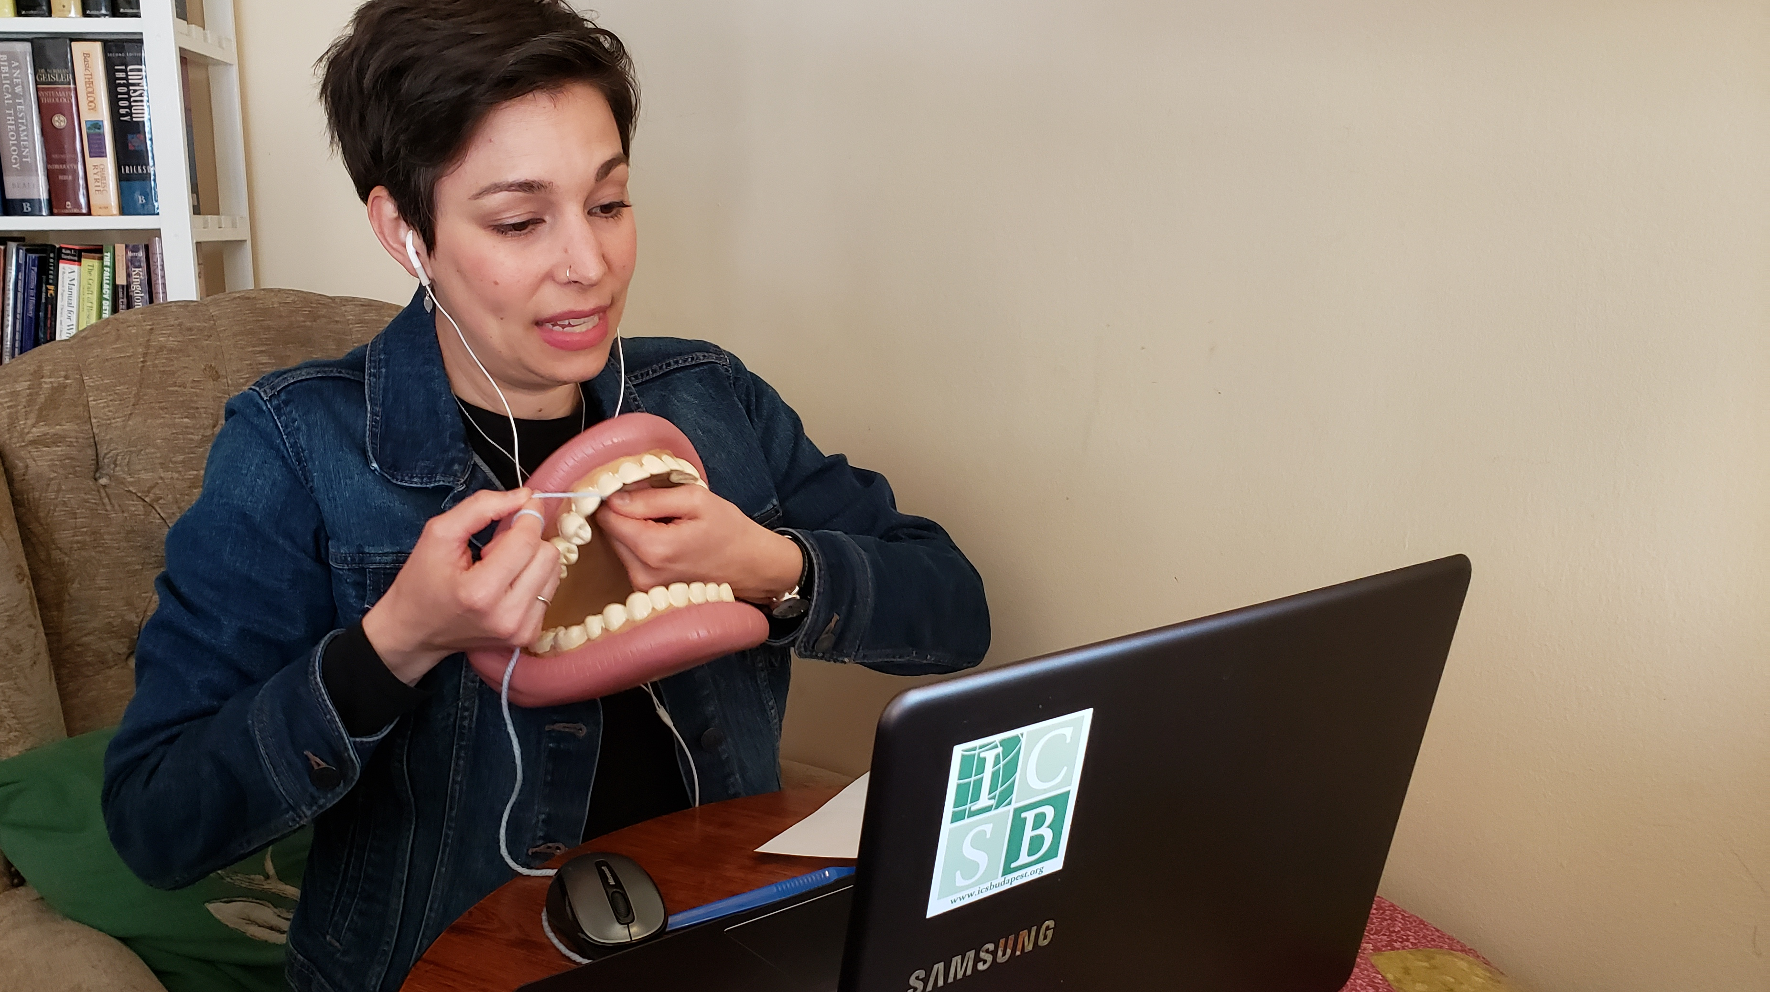
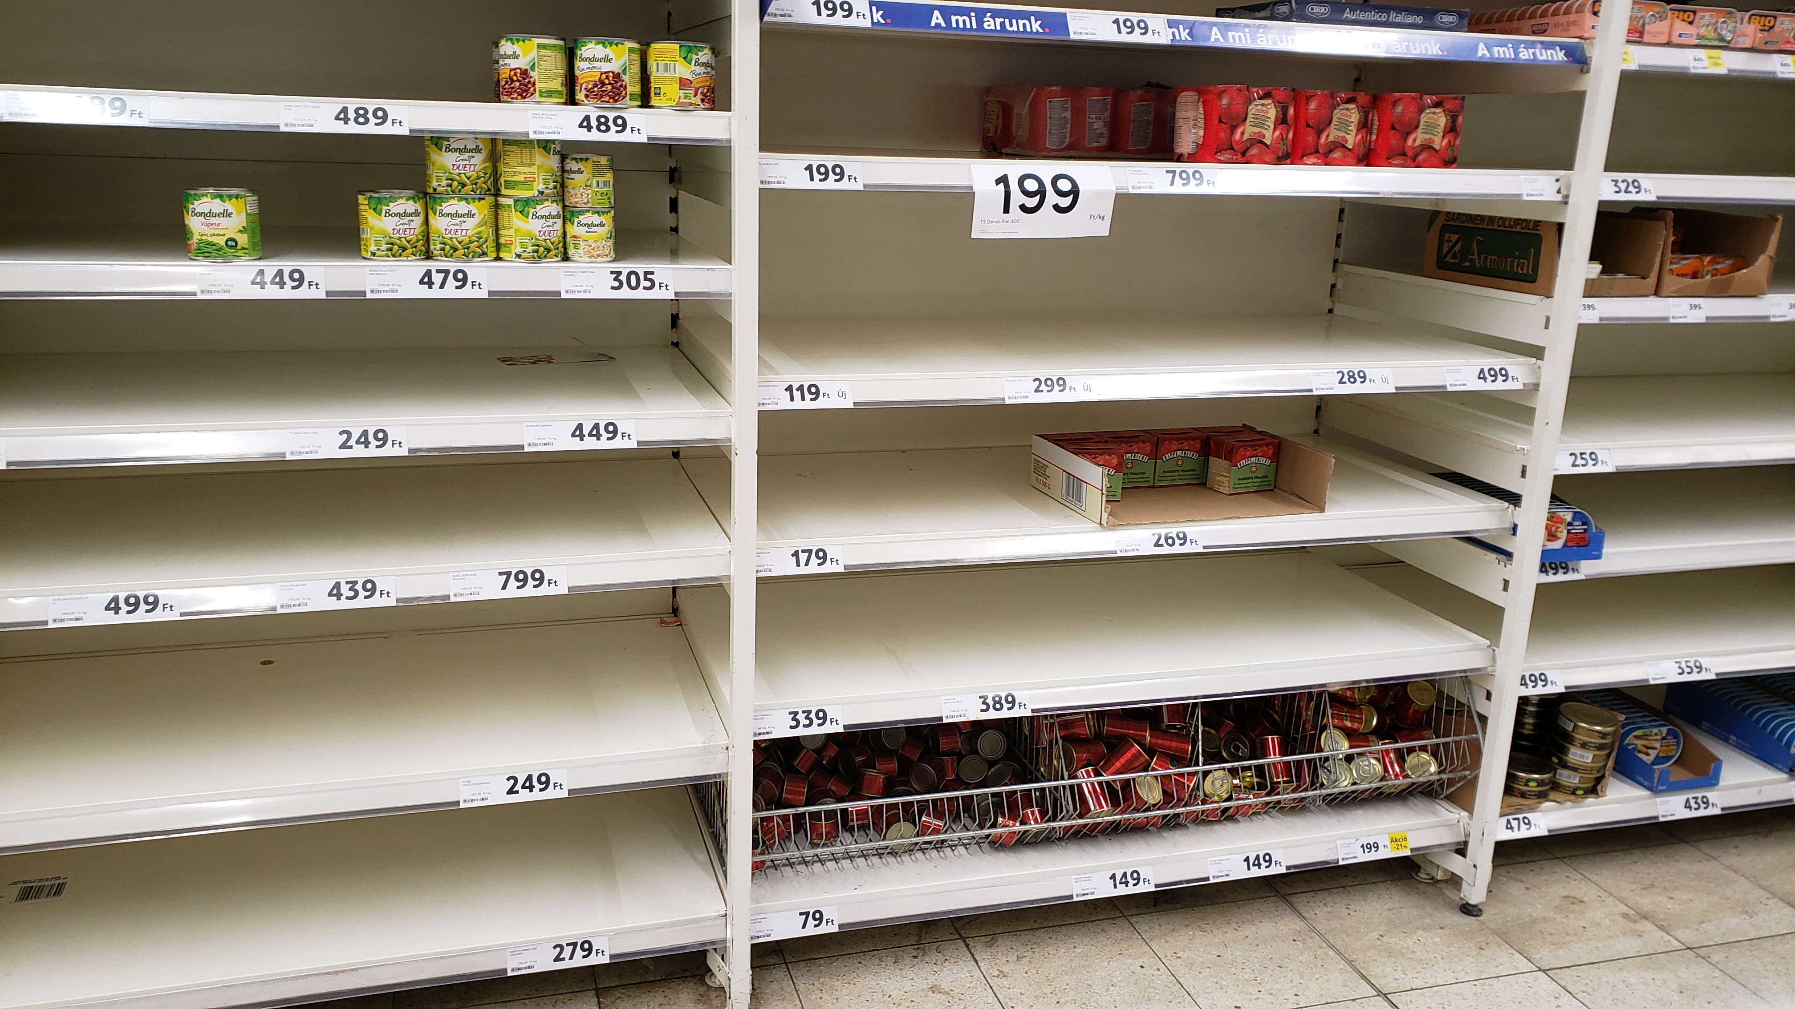
Challenge
Notes:
Like all of you, we have faced some unique challenges these past several years.
Intense stress and pressure this school year due to Covid.
Hungarian emergency powers changed rules every 2-4 weeks – meant weeks of planning for contingencies or events that never materialized and moving in and out of distance learning.
During the 3rd wave in the spring of 2021, one of the highest rates in Europe, and one of the highest mortality rates in the world. – the ICSB EG principal died as well and Dave took over
Events took an unexpected turn with the outbreak of war in neighboring Ukraine.
On February 24, 2022, Russia invaded Ukraine and changed the shape of our modern world. Hungary borders Ukraine, so thousands of Ukrainian refugees flooded into the country. In an emergency rush, we processed and accepted more than 30 students to our school, so that Ukrainians now make up more than 10% of our student body.
As a result of the war, Hungary has undergone inflation rates in mid 20s% - higher than any other European country, including Ukraine. As a comparison, US inflation topped out at 9% and is currently at about 4.5%. To even get close to what Hungary is going through, you’d have to go to the US in 1946, when inflation hit 18%. Part of the result of inflation and government price caps are lots of empty shelves and lines.

Slide 9
Celebration Defined
Public Acknowledgement of Something Good
Sabbath: Rest
Passover: Redemption
First Fruits: Physical Needs
Tabernacles: God’s Presence
Notes:
Clearly we all understand and are familiar with challenges, so we can understand the “always” of Paul’s command.
Understanding joy and celebration, especially within hardship, is more difficult.
The link between joy and celebration is strong throughout scripture, but perhaps best evidenced in Nehmiah 8:10
Israel is mourning because of their sin, but repents.
They are commanded to stop mourning and to celebrate a great festival.
Then they are reminded that the joy of the Lord is their strength. Joy and celebration go together.
To ensure we are on the same page, a celebration is a public acknowledgement of something good.
God highlights the importance of celebration throughout scripture, particularly in the OT:
Sabbath – recognizing God’s provision of rest
Passover – recognizing God’s provision of redemption
First Fruits – recognizing God’s provision for physical needs
Trumpets, Atonement, and Tabernacles – recognizing God’s provision of his very presence among his people
To celebrate as a Christian is to affirm one’s trust in God and his good provision in the presence of others.
Not being happy about bad things that happen
Is acknowledging the good things in the midst of the ordinary or bad

Slide 10
2. Choose to Celebrate by:
a. Focusing on God’s Sovereignty
⁶ Do not be anxious about anything, but in every situation, by prayer and petition, with thanksgiving, present your requests to God.
Notes:
As all of us know, choosing to celebrate in the doldrums and challenges of life is much easier said than done.
Paul realized this and described how to choose joyous celebration, even in the worst situations.
First, Paul says part of celebrating is NOT doing something: worrying
This kind of worrying is the unhealthy focus on what we don’t have. Worry is ultimately an attempt to control our circumstances.
You can’t celebrate if you are worried and trying to control things! Paul says to be “carefree” by:
Praying – this is a worship mindset, re-orienting our focus to God
Petition – this is asking God for what we need and trusting him to supply our true needs – which are ultimately spiritual
Thanksgiving – recognizing what God has done
Ultimately, this is a recognition that God is sovereign, in control, and good (and we are not).

Slide 11
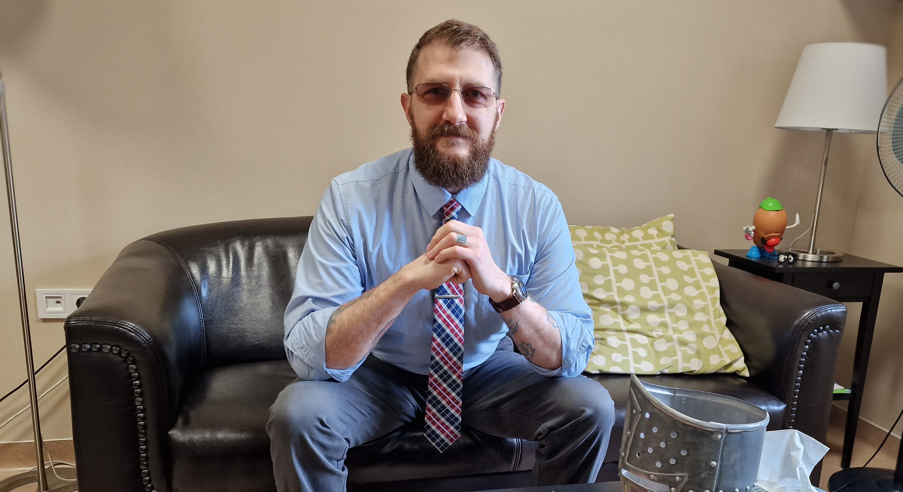
Notes:
As we work to proclaim the gospel, disciple people, and support missionaries, we have had plenty of obstacles and cause for worry.
Repeatedly, we have any illusions of our control and sovereignty stripped away as we seek to rely on God day-by-day.
Over the last two years my role has changed significantly in HOW we meet our goals, and we have seen God’s sovereign work.
2021-2023 Principal of restructured P-8 school; no direct teaching of students.
More parent interaction, often in the context of challenges.
More opportunities to proclaim and disciple struggling students 1:1.
More discipling and support of teachers as they work directly with students.
Jenn continues to teach Health 6-8 and serve on the Child Safety team
Focusing on God’s sovereignty is essential for us to avoid living in a state of overwhelm and anxiety as we minister to TCKs.

Slide 12
2. Choose to celebrate by:
b. Focusing on God’s
Provision
whatever is: true, noble, right, pure, lovely, admirable—if anything is excellent or praiseworthy—think about such things.
Notes:
Second, Paul tells us that focus on God’s good provision is essential.
Paul challenged the Philippians to see God’s provision in all circumstances.
Doesn’t ignore the bad, but chooses to focus on the good as we move through the dark valleys
If God is sovereign in this world, then every good and perfect gift is from God.
Yes, there are lots of bad things in this world, and we cannot and should not ignore them.
But we are not to concentrate on the bad, which develops a “doom-and-gloom” view of God’s world.
We are called to recognized the truth, beauty, and good wherever it is found in God’s world (even if it is not explicitly “Christian”)
We are called to live in this world with gratitude, not holding a “pessimistic stance” “with a scowl” on our faces.
We can’t help but be joyful when we see those true, right, lovely things that God graciously allows to shine through in his world.

Slide 13
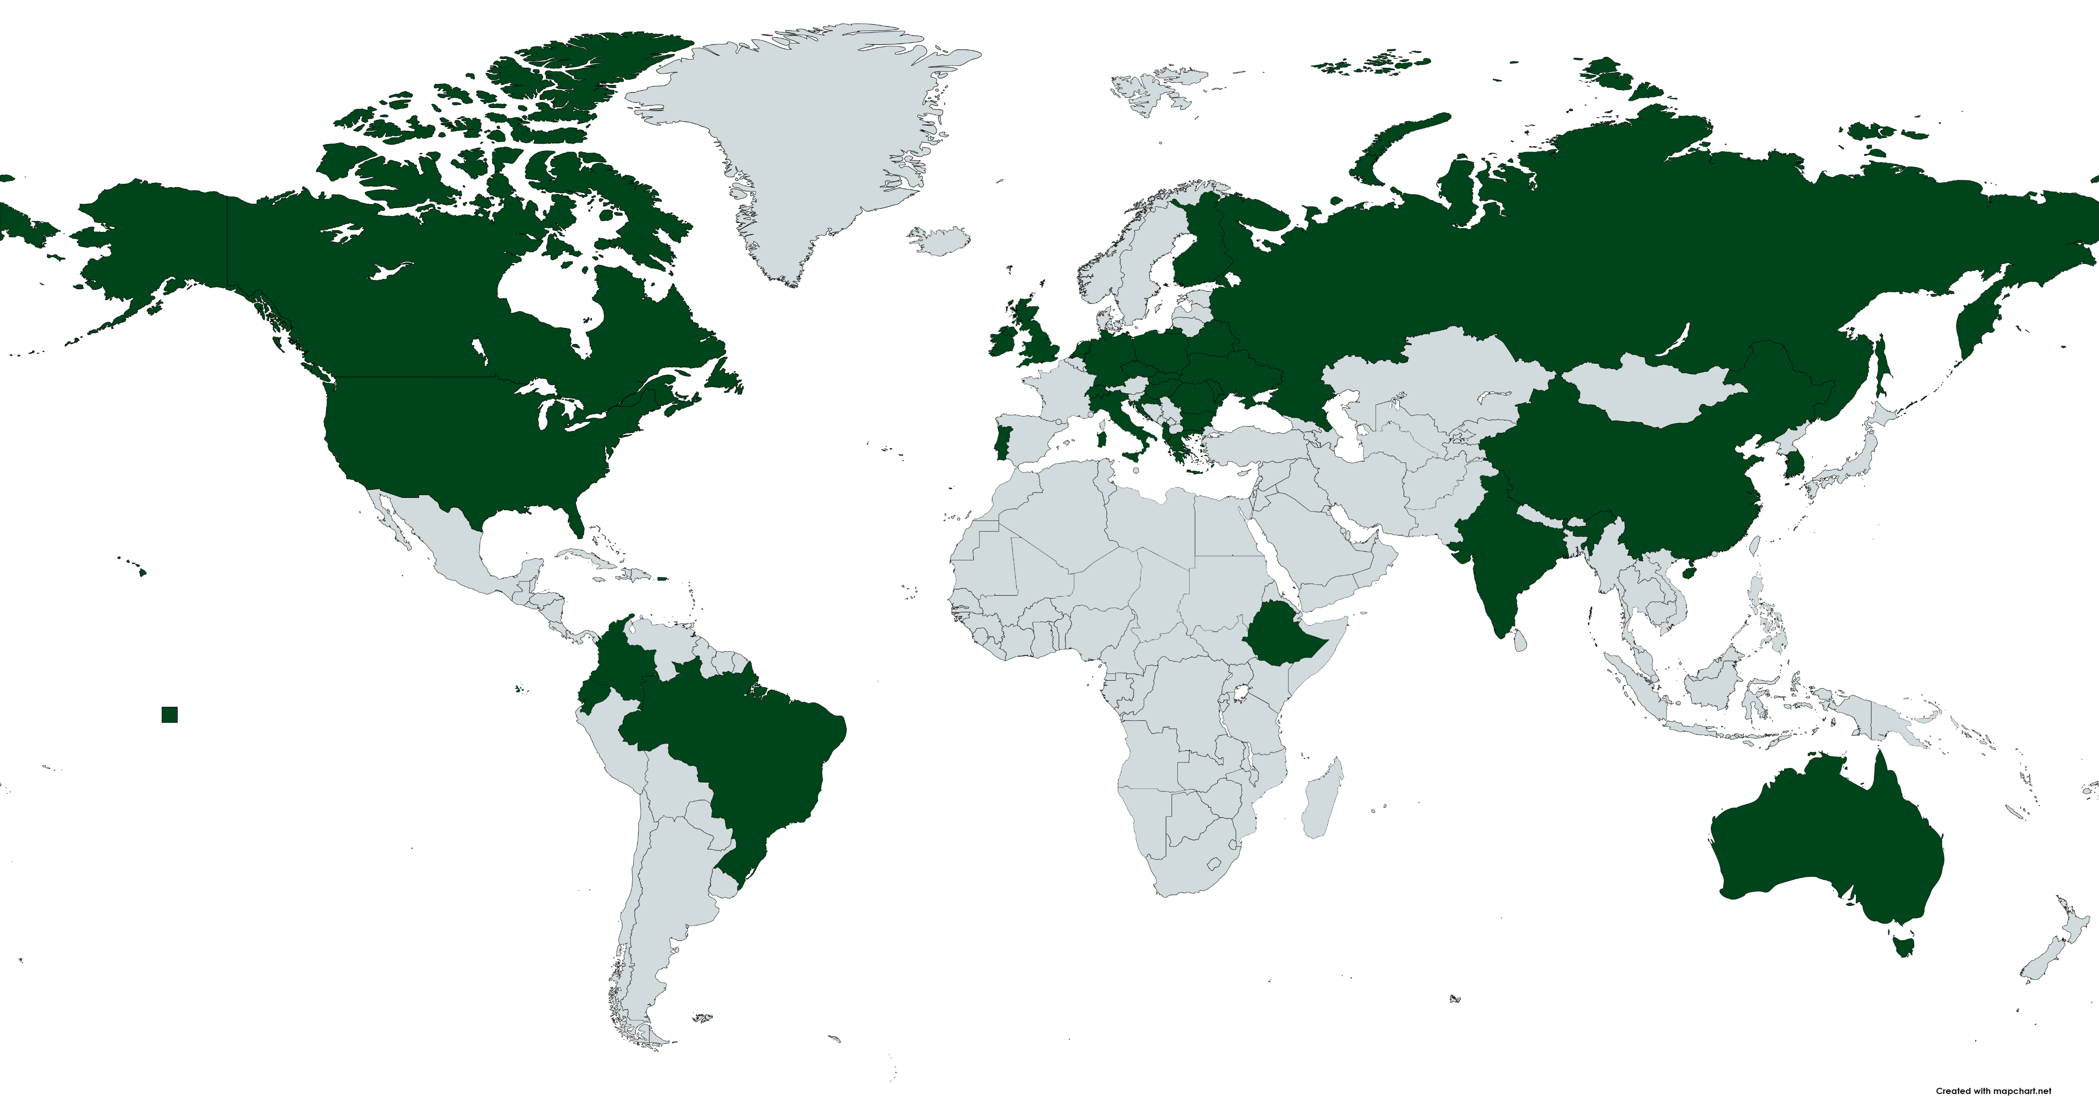
350+
Third-Culture Kids,
More than 20 nations
Notes:
We have seen God’s provision over the past 10 years we have lived in Hungary.
By God’s grace, we have:
ministered to over 350 TCKs from over 20 different countries. Having been there 10 years, we even saw a former student of our return to teach at the school!
supported missionaries from around the world who work in countries across Europe. Every year, parents tell us they could not remain on the field if it weren’t for the ministry of ICSB.
Through grief, war, shortages, and tears God’s goodness and faithfulness remains. Focusing with a grateful heart on God’s good provision, keeps us from living in a state of despair.

Slide 14
3. When we joyously celebrate, we have:
God and His Peace
⁷ And the peace of God, which transcends all understanding, will guard your hearts and your minds in Christ Jesus.
⁹ …put it into practice. And the God of peace will be with you.
Notes:
Something amazing and supernatural happens when we focus on God’s sovereignty and provision and joyously celebrate.
The Peace of God is a supernatural contentment, even in the face of great challenge. Paul has a beautiful description of this peace of God in 4:10-13, in which he describes contentment in the face of imprisonment, and declaration that he can “do all these things through Christ who” strengthened him.
God’s peace makes joyous celebration possible, regardless of circumstances.

Slide 15
How will you choose to celebrate?
^{Consider}
1. Without comparing to others, how has God gifted you?
2. Through challenges, how has God grown you?
3. Celebration is PUBLIC. How can you share God’s goodness with others?

Slide 16
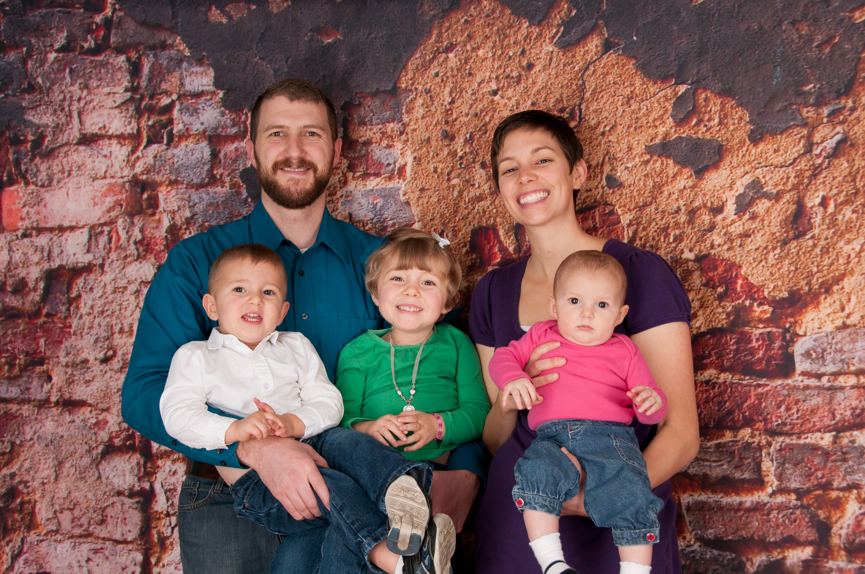
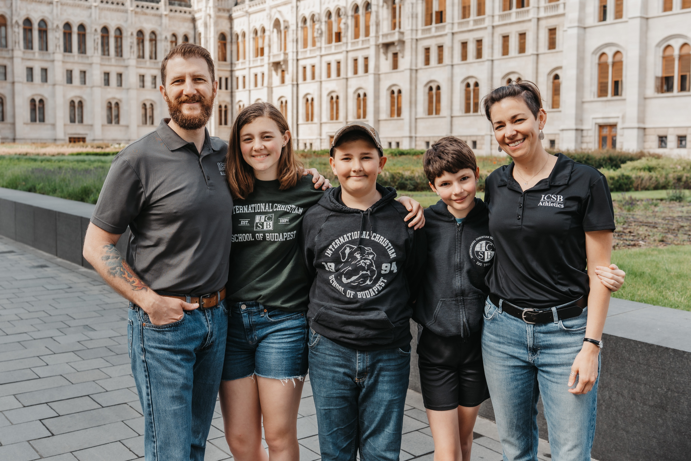
10 Years!
Thank you for your faithful partnership
Notes:
³ I thank my God every time I remember you. ⁴ In all my prayers for all of you, I always pray with joy ⁵ because of your partnership in the gospel from the first day until now, ⁶ being confident of this, that he who began a good work in you will carry it on to completion until the day of Christ Jesus.

