Slide 1
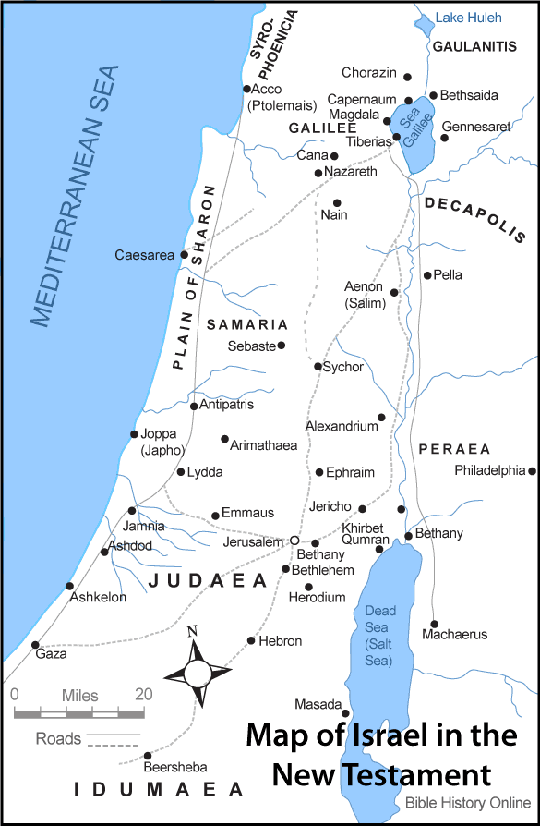

Slide 2
Why Study Acts?
Importance of Origins (Origins Determine Conclusions)
We worked through Genesis (The origin of everything)
“In the beginning, God created the heavens and the earth.”
- Genesis 1:1
We are working through Acts (The Origin of the Church)
“And the Lord added to the Church daily those who were being saved.”
- Acts 2:47

Slide 3
Acts Transitions
1. Doctrinal Transition: From an immature view of the cross to a fuller understanding of what Jesus has done for us.
2. Communal Transition: From a Jewish sect to a worldwide Christian community.
3. Focal Transition: From an earthly kingdom focus to a spiritual kingdom focus.
4. Geographical Transition: From Jerusalem to Rome.
5. Theological Transition: From Christ present to Spirit present.
6. Identity Transition: Individually, from Jew to Christian.
7. National Transition: From scattered nations (Babel) to one people.

Slide 4
Acts 10:1-8
“Now there was a man in Caesarea named Cornelius, a centurion of what was called the Italian cohort, a devout man and one who feared God with all his household, and made many charitable contributions to the Jewish people and prayed to God continually. About the ninth hour of the day he clearly saw in a vision an angel of God who had just come in and said to him, “Cornelius!” And he looked at him intently and became terrified, and said, “What is it, lord?” And he said to him, “Your prayers and charitable gifts have ascended as a memorial offering before God. Now dispatch some men to Joppa and send for a man named Simon, who is also called Peter; he is staying with a tanner named Simon, whose house is by the sea.” When the angel who *spoke to him left, he summoned two of his servants and a devout soldier from his personal attendants, and after he had explained everything to them, he sent them to Joppa.”

Slide 5
Practical Application
Recognize that God is pursuing you.
- Romans 5:8
Make yourself available.
- Matthew 4:19
Hear the Lord.
- John 10:27
Do what God tells you to do. John
-14:23

