Slide 1
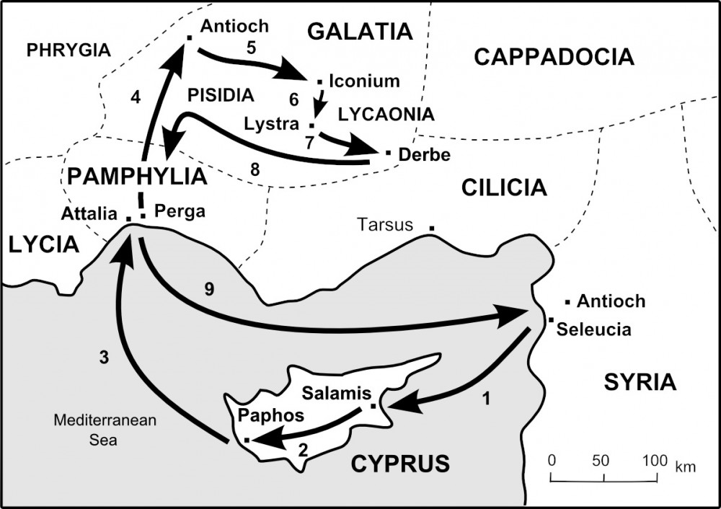

Slide 2
Walking the Roman Road
Romans 3:10-12 (Our history and our condition)
Romans 3:23 (Our need – The problem)
Romans 6:23 (What we all deserve - Death)
Romans 5:8 (God made a way for us to be made right with Him)
Romans 10:9-13 (The simple truth –the Good News!)
Romans 8:1 (Freedom! Life!)
This all hinges on one set of FACTS:
1 Corinthians 15:3-8
If there is no resurrection, there is no hope, and no meaning to anything...

Slide 3
