Slide 1
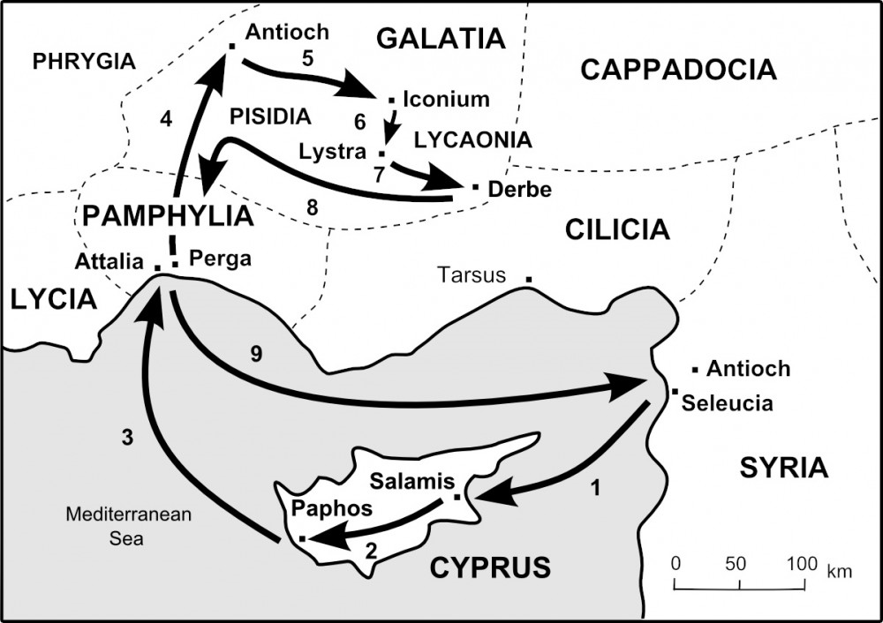

Slide 2
Acts 13:1-5 Points of Application
Mark 12:30
“...you shall love the Lord your God with all your heart, with all your soul, with all your mind, and with all your strength.”
1. They Worshiped = They offered their Hearts
(Acts 13:2)
They Fasted = They offered their Minds
(Acts 13:2)
They Prayed = They offered their Souls
(Acts 13:3)
They Acted = They offered their Strength
(Acts 13:4)

Slide 3
Early Church Missionary Tactics of the Holy Spirit
1. An “Urban First” Approach (fish where the fish are)
2. Emphasis on Training (equipping the saints for the work...)
3. Use of the Natural Background and Resources of Missionaries (God has provided these things for a reason)
4. Evangelism First, then Teaching (make, baptize, teach disciples)
5. To the Jews First, then Gentiles...(the sequence never varies)

Slide 4
Today’s Points of Emphasis
1. Satan will approach you in person
2. Satan will always appeal to your fleshly desire
3. Satan can only lie and deceive
4. Satan cannot withstand the truth of God’s Word

Slide 5
Today’s Points of Application
James 4:7
“Therefore submit to God. Resist the devil and he will flee from you.”
1. Submit to God – John 10:27 “My sheep know My voice, and I know them, and they follow Me.”
2. Resist the Devil – Ephesians 6:13 “Therefore take up the whole armor of God, that you may be able to withstand in the evil day, and having done all, to stand.”

Slide 6
Bonus Slide (No Extra Charge)
Ephesians 6:10-17
“Finally, my brethren, be strong in the Lord and in the power of His might. 11 Put on the whole armor of God, that you may be able to stand against the wiles of the devil. 12 For we do not wrestle against flesh and blood, but against principalities, against powers, against the rulers of the darkness of this age, against spiritual hosts of wickedness in the heavenly places. 13 Therefore take up the whole armor of God, that you may be able to withstand in the evil day, and having done all, to stand.
14 Stand therefore, having girded your waist with truth, having put on the breastplate of righteousness, 15 and having shod your feet with the preparation of the gospel of peace; 16 above all, taking the shield of faith with which you will be able to quench all the fiery darts of the wicked one. 17 And take the helmet of salvation, and the sword of the Spirit, which is the word of God...”

