Slide 1
Acts 12:20-24
“Now Herod had been very angry with the people of Tyre and Sidon; but they came to him with one accord and having made Blastus the king’s personal aide their friend, they asked for peace, because their country was supplied with food by the king’s country. 21 So on a set day Herod, arrayed in royal apparel, sat on his throne and gave an oration to them. 22 And the people kept shouting, “The voice of a god and not of a man!” 23 Then immediately an angel of the Lord struck him, because he did not give glory to God. And he was eaten by worms and died. 24 But the word of God grew and multiplied.”

Slide 2
Ain’t Pride Great?
Pride has us elevate ourselves and our desires above all else.
Pride has us protect ourselves and our interests at all costs.
Pride compels us to inconsideration for others and for God.
Pride is the opposite of love.

Slide 3
Today’s Application/Point of Emphasis
Humble yourself in the sight of the Lord - James 4:10
“Humble yourselves in the sight of the Lord, and He will lift you up.”
What does this look like in practice?
⁹ Let love be without hypocrisy. Abhor what is evil. Cling to what is good. ¹⁰ Be kindly affectionate to one another with brotherly love, in honor giving preference to one another; ¹¹ not lagging in diligence, fervent in spirit, serving the Lord; ¹² rejoicing in hope, patient] in tribulation, continuing steadfastly in prayer; ¹³ distributing to the needs of the saints, given] to hospitality.”

Slide 4
For Those of Us Who Call Ourselves Christians
“Being that pride is the natural state of humanity, the mark of a life changed by Jesus Christ is humility.”

Slide 5
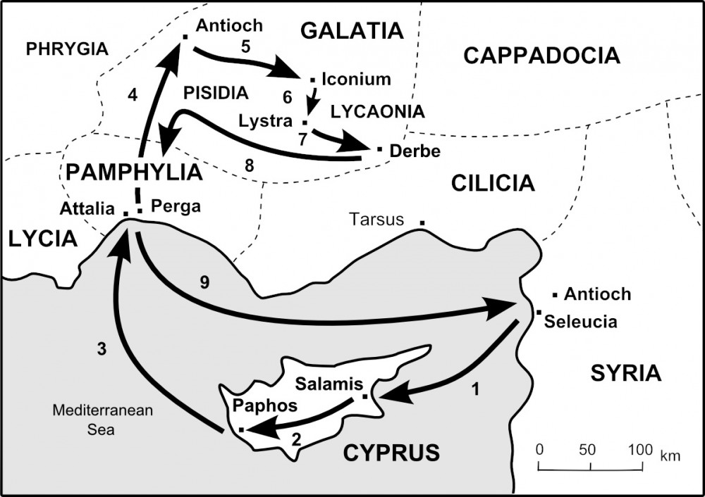

Slide 6
Acts 13:1-5
“Now in the church that was at Antioch there were certain prophets and teachers: Barnabas, Simeon who was called Niger, Lucius of Cyrene, Manaen who had been brought up with Herod the tetrarch, and Saul. ² As they ministered to the Lord and fasted, the Holy Spirit said, “Now separate to Me Barnabas and Saul for the work to which I have called them.” ³ Then, having fasted and prayed, and laid hands on them, they sent them away. ⁴ So, being sent out by the Holy Spirit, they went down to Seleucia, and from there they sailed to Cyprus. ⁵ And when they arrived in Salamis, they preached the word of God in the synagogues of the Jews. They also had John as their assistant.”

Slide 7
Today’s Points of Application
Mark 12:30
“...you shall love the Lord your God with all your heart, with all your soul, with all your mind, and with all your strength.”
1. They Worshiped = They offered their Hearts
(Acts 13:2)
They Fasted = They offered their Minds
(Acts 13:2)
They Prayed = They offered their Souls
(Acts 13:3)
They Acted = They offered their Strength
(Acts 13:4)

