Slide 1
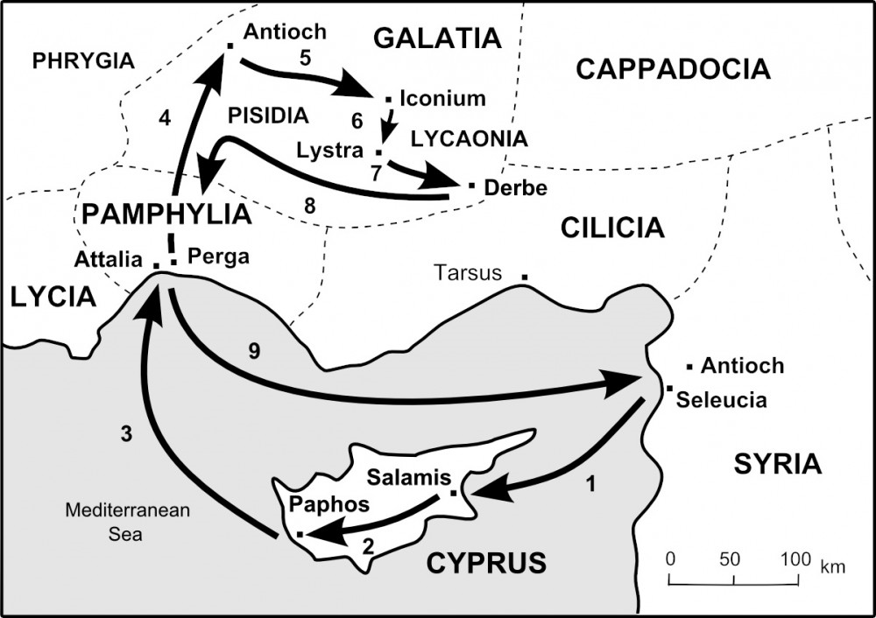

Slide 2
Acts 13 So far...
Paul and Barnabas are set apart by the Holy Spirit through prayer and fasting and are sent out from Antioch.
Paul and Barnabas meet with Sergius Paulus, who is saved, despite opposition from Bar-Jesus
Paul and Barnabas land at Perga, where John Mark drops out.
From there, Paul and Barnabas cross the treacherous passes of the Taurus Mountains and come to Pisidian Antioch.
Paul is asked to speak at the Synagogue, and Paul gives his first recorded sermon.
Paul sets a gospel framework.
He proves from scripture that: God has always provided for His chosen people, He assures his hearers that God’s gifts have culminated in Jesus, the Messiah and Savior of the people, He backs up this claim with the testimony of John the Baptist, from the rejection of Jesus which fulfills the foretelling of the prophets, and mainly from the resurrection, which was witnessed by living men, and which was foretold in the Psalms.
Paul closes with an appeal to accept the forgiveness of sins Jesus offers, and with a warning against unbelief, taken from the Old Testament scriptures.
The gentiles in the city beg Paul to speak to them on the next sabbath.
Paul continues preaching to the Jews and proselytes after the sabbath, and persuades them to continue in their belief, in the grace of God.

Slide 3
Walking the Roman Road
Romans 3:10-12 (Our history and our condition)
Romans 3:23 (Our need – The problem)
Romans 6:23 (What we all deserve - Death)
Romans 5:8 (God made a way for us to be made right with Him)
Romans 10:9-13 (The simple truth –the Good News!)
Romans 8:1 (Freedom! Life!)
This all hinges on one set of FACTS:
1 Corinthians 15:3-8
If there is no resurrection, there is no hope, and no meaning to anything...

Slide 4
Acts 13:44-52
“On the next Sabbath almost the whole city came together to hear the word of God. ⁴⁵ But when the Jews saw the multitudes, they were filled with envy; and contradicting and blaspheming, they opposed the things spoken by Paul. ⁴⁶ Then Paul and Barnabas grew bold and said, “It was necessary that the word of God should be spoken to you first; but since you reject it, and judge yourselves unworthy of everlasting life, behold, we turn to the Gentiles. ⁴⁷ For so the Lord has commanded us: I have set you as a light to the Gentiles, That you should be for salvation to the ends of the earth.’ ”
⁴⁸ Now when the Gentiles heard this, they were glad and glorified the word of the Lord. And as many as had been appointed to eternal life believed. ⁴⁹ And the word of the Lord was being spread throughout all the region. ⁵⁰ But the Jews stirred up the devout and prominent women and the chief men of the city, raised up persecution against Paul and Barnabas, and expelled them from their region. ⁵¹ But they shook off the dust from their feet against them, and came to Iconium. ⁵² And the disciples were filled with joy and with the Holy Spirit.”

Slide 5
Summary of Acts 13:44-52
The Jews are angry before Paul even starts – They are envious
Paul confronts them directly – “This good news has been offered to you first, but you have rejected it! Therefore, you have judged yourselves!”
Paul shocks them by telling them he is turning to the Gentiles.
The Gentiles glorify the word of the Lord
As many as were appointed to eternal life believed
The word of the Lord was spread throughout the region
Persecution (Satanic opposition) came upon them, but they moved on with joyful hearts.

Slide 6
Points of Emphasis/Application
The Gospel Message of Jesus Christ will always create tension.
Matthew 10:21-22
There will always be those who respond to the gospel
Romans 8:29-30
You can rely on the Holy Spirit
John 14:16-17
4. There is great joy in persecution – There is a special blessing for those who are persecuted.
Matthew 5:11-12

