Slide 1
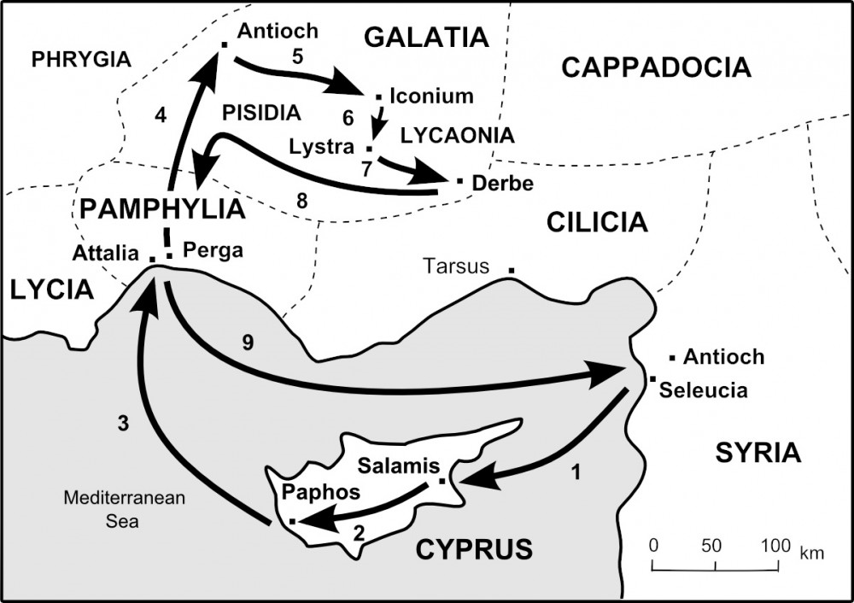

Slide 2
Reactions to the Gospel of Jesus Christ
Belief – Acts 13:48
Rejection – Romans 1:18-23
Anger
Perversion/Mysticism
Human Secularism = Humanism = Satanism
Total Indifference

Slide 3
Acts 14:1-18 Application
Continually seek discernment from the Holy Spirit
(within and without) Hebrews 4:13
2. Do not elevate yourself above Jesus
Colossians 1:16-17
3. Do not allow others to elevate you above Jesus
Romans 12:3
4. Do not elevate ANYONE above the Lord Jesus Christ
John 8:58

Slide 4
Phases of Ministry from Acts 14
1. Strengthening the souls of the disciples.
(Discipleship = to teach )
2. Exhorting them to continue in the faith.
(Exhortation = to make an urgent appeal)
3. “We must through many tribulations enter the kingdom of God.”
(Encouragement = to give one courage)

Slide 5
Application from Acts 14:19-28
Be Bold - Romans 1:16
Be Available - Ephesians 2:10
3. Be Engaged - 1 Corinthians 12:26-27

