Slide 1
3 Phases of Saul’s Transformation
1. Conviction of Sin (9:1-9)
2. Understanding who Christ is and why it matters (9:10-19)
3. Confession and proclamation of Christ’s supremacy and Paul’s personal faith (9:20-31)

Slide 2
Damascus Road Basic Doctrinal Truths – Acts 9:1-7
We are saved by Grace
– Ephesians 2:1-10
Jesus is the Son of God
– Colossians 1:13-17
Only believers in the Lord Jesus Christ are His People
- Philippians 3:7-9
We (His people) are the Body of Christ
- 1 Corinthians 12:12-14

Slide 3
Saul’s Salvation Story
1. Lost in Sin and Self-Righteousness
2. Convicted of Sin - Miraculously Redeemed
3. Obedient to the Word of God
4. Filled with the Holy Spirit
5. Healed and Baptized
6. Discipled by Jesus Himself in Arabia
7. Preaches Jesus as the Christ in Damascus and Israel
8. Persecuted and Protected

Slide 4
Acts 9 Application/Reflection Questions
1. Have you truly been convicted of your sin? And has there been real repentance in your life?
2. Have you identified with the risen Christ and are you obedient to His word and His Spirit within you?
3. Are you being conformed to His image? Have you noticed change in your life and in who you are?

Slide 5
Acts 9:32-43
“Now as Peter was traveling through all those regions, he came down also to the saints who lived at Lydda. 33 There he found a man named Aeneas, who had been bedridden eight years, for he was paralyzed. 34 Peter said to him, “Aeneas, Jesus Christ heals you; get up and make your bed.” Immediately he got up. 35 And all who lived at Lydda and Sharon saw him, and they turned to the Lord.
36 Now in Joppa there was a disciple named Tabitha (which translated in Greek is called Dorcas); this woman was abounding with deeds of kindness and charity which she continually did. 37 And it happened at that time that she fell sick and died; and when they had washed her body, they laid it in an upper room. 38 Since Lydda was near Joppa, the disciples, having heard that Peter was there, sent two men to him, imploring him, “Do not delay in coming to us.” 39 So Peter arose and went with them. When he arrived, they brought him into the upper room; and all the widows stood beside him, weeping and showing all the tunics and garments that Dorcas used to make while she was with them. 40 But Peter sent them all out and knelt down and prayed, and turning to the body, he said, “Tabitha, arise.” And she opened her eyes, and when she saw Peter, she sat up. 41 And he gave her his hand and raised her up; and calling the saints and widows, he presented her alive. 42 It became known all over Joppa, and many believed in the Lord. 43 And Peter stayed many days in Joppa with a tanner named Simon.”

Slide 6
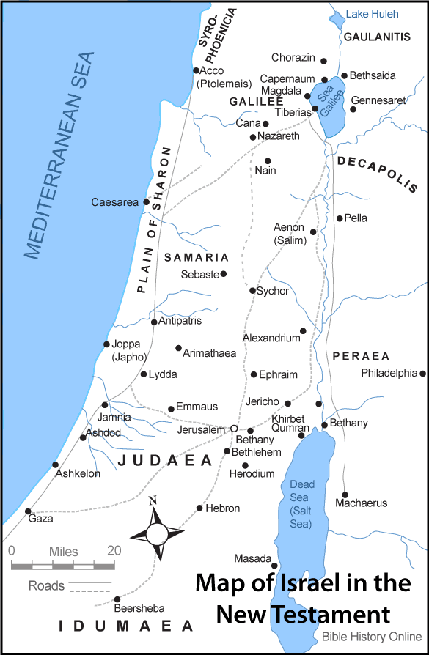

Slide 7
3 Takeaways from Today’s Passage
1. True Miracles will ALWAYS glorify Jesus and draw people toward Him
2. The Power is in the name of Jesus Christ
3. The result of a true miracle is always that more people come to saving faith in Jesus Christ

Slide 8
Today’s Points of Application
1. Rightly discern regarding miracles. Who is being worshiped?
Rightly recognize the power.
Who is being worshiped?
Rightly judge the fruit.
Who is being worshiped?

