Slide 1
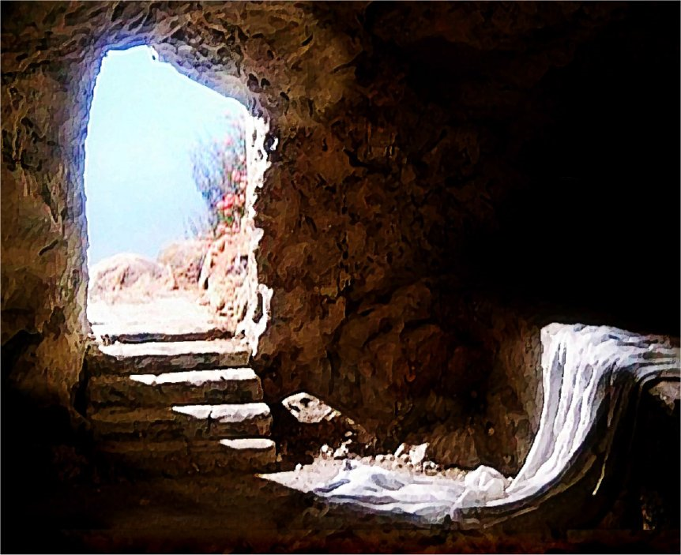

Slide 2
The Problem
God Sets the Expectation (Genesis 2:15-17)
“Then the Lord God took the man and put him in the garden of Eden to tend and keep it. ¹⁶ And the Lord God commanded the man, saying, “Of every tree of the garden you may freely eat; ¹⁷ but of the tree of the knowledge of good and evil you shall not eat, for in the day that you eat of it you shall surely die.”
Man Fails to Meet the Expectation (Genesis 3:1-24) Read with me…
Blood Must be Shed (Leviticus 17:11, Genesis 9:5-6)
“For the life of the flesh is in the blood, and I have given it to you upon the altar to make atonement for your souls; for it is the blood that makes atonement for the soul.’”
“Surely for your lifeblood I will demand a reckoning; from the hand of every beast I will require it, and from the hand of man. From the hand of every man’s brother I will require the life of man. “Whoever sheds man’s blood, By man his blood shall be shed; For in the image of God He made man.”

Slide 3
The Solution
Jesus is the Promise (Genesis 3:15)
“And I will put enmity Between you and the woman, And between your seed and her Seed; He shall bruise your head, And you shall bruise His heel.”
Jesus Became Flesh (John 1:14)
“And the Word became flesh and dwelt among us, and we beheld His glory, the glory as of the only begotten of the Father, full of grace and truth.”
Jesus Became the Sacrifice (1 Corinthians 15:3-4, 20-22)
“For I delivered to you first of all that which I also received: that Christ died for our sins according to the Scriptures, ⁴ and that He was buried, and that He rose again the third day according to the Scriptures…”
²⁰ But now Christ is risen from the dead and has become the firstfruits of those who have fallen asleep. ²¹ For since by man came death, by Man also came the resurrection of the dead. ²² For as in Adam all die, even so in Christ all shall be made alive.

Slide 4
The Response
He Who Believes (Romans 10:9, 13)
”…if you confess with your mouth the Lord Jesus and believe in your heart that God has raised Him from the dead, you will be saved.”
“…whoever calls on the name of the Lord shall be saved.”
He Who Does Not Believe (Romans 1:18-21)
“For the wrath of God is revealed from heaven against all ungodliness and unrighteousness of men, who suppress the truth in unrighteousness, ¹⁹ because what may be known of God is manifest in them, for God has shown it to them. ²⁰ For since the creation of the world His invisible attributes are clearly seen, being understood by the things that are made, even His eternal power and Godhead, so that they are without excuse, ²¹ because, although they knew God, they did not glorify Him as God, nor were thankful, but became futile in their thoughts, and their foolish hearts were darkened.”

Slide 5
The Consequence
Either You are, or You are not, SAVED. (John 3:36)
“He who believes in the Son has everlasting life; and he who does not believe the Son shall not see life, but the wrath of God abides on him.”

Slide 6
Tony Borton
307-631-7544

