Slide 1
Romans 1:18-20
“For the wrath of God is revealed from heaven against all ungodliness and unrighteousness of men, who suppress the truth in unrighteousness, because what may be known of God is manifest in them, for God has shown it to them. For since the creation of the world His invisible attributes are clearly seen, being understood by the things that are made, even His eternal power and Godhead, so that they are without excuse…”

Slide 2
Two Conflicting Viewpoints
Biblical Christian Perspective
God’s word (the Bible) is true.
Origin: God. Intelligence, Order and Purpose.
How all things began:
“In the beginning, God…”
Pagan Perspective
Man determines truth.
Origin: Unknown. Impersonal chance and randomness.
How all things began:
“In the beginning, gas…”

Slide 3
Exodus 20:3
“You shall have no other gods before me.”

Slide 4
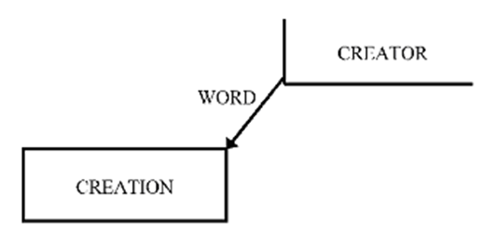
Genesis 1:1 “In the beginning, God created the heavens and the earth.”

Slide 6
Application
1. Understand who God is, and who you are (Exodus 20:3, Ephesians 2:10)
2. Submit to His authority over you (James 4:7, 1 Peter 5:6)
3. Rest in Him (Psalm 46:10, Psalm 34:7-9)

