Slide 1
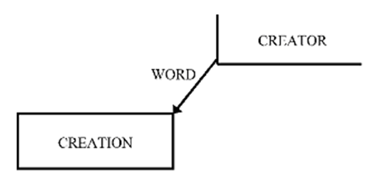
Numbers 23:19
“God is not a man, that He should lie, Nor a son of man, that He should repent.”
John 4:24
“God is Spirit, and those who worship Him must worship in spirit and truth.”

Slide 2
Omnipresent: The state of being present everywhere all the time
Psalm 139:7-12
“Where can I go from Your Spirit? Or where can I flee from Your presence? ⁸ If I ascend into heaven, You are there; If I make my bed in hell, behold, You are there. ⁹ If I take the wings of the morning, And dwell in the uttermost parts of the sea, ¹⁰ Even there Your hand shall lead me, And Your right hand shall hold me. ¹¹ If I say, “Surely the darkness shall fall on me,” Even the night shall be light about me; ¹² Indeed, the darkness shall not hide from You, But the night shines as the day; The darkness and the light are both alike to You.”

Slide 3
Purely, Perfectly, Personally Present
Isaiah 57:15
“For thus says the High and Lofty One
Who inhabits eternity, whose name is Holy:
“I dwell in the high and holy place, and
With him who has a contrite and humble spirit,
To revive the spirit of the humble,
And to revive the heart of the contrite ones.

Slide 4
Present in ALL space AND time
John 8:57-58
“Your father Abraham rejoiced to see My day, and he saw it and was glad.” Then the Jews said to Him, “You are not yet fifty years old, and have You seen Abraham?” Jesus said to them, “Most assuredly, I say to you, before Abraham was, I AM.”

Slide 5
His presence in all time extends to us
Ephesians 2:4-6
“But God, who is rich in mercy, because of His great love with which He loved us, even when we were dead in trespasses, made us alive together with Christ (by grace you have been saved), and raised us up together, and made us sit together in the heavenly places in Christ Jesus…”

Slide 6
The ways of a man seem right to him…
Romans 1:18-20
“For the wrath of God is revealed from heaven against all ungodliness and unrighteousness of men, who suppress the truth in unrighteousness, because what may be known of God is manifest in them, for God has shown it to them. For since the creation of the world His invisible attributes are clearly seen, being understood by the things that are made, even His eternal power and Godhead, so that they are without excuse…”

Slide 7
Stumbling in the dark…
Ephesians 4:17-18
“This I say, therefore, and testify in the Lord, that you should no longer walk as the rest of the Gentiles walk, in the futility of their mind, having their understanding darkened, being alienated from the life of God, because of the ignorance that is in them, because of the blindness of their heart…”

Slide 8
Application:
Recall the times you have thought that God was not near. Recognize that he was present all along. How does that change how you feel? God has always been as close as your own breath (Job 27:3, Psalm 139:13-18)
Remind yourself where God is in space and time both generally and regarding you personally (Isaiah 41:10, Joshua 1:9)
Reflect on how this knowledge about God applies to you generally and to a specific problem you have (Philippians 1:6, Deuteronomy 31:6-8)
Homework:
Think about your worst problem. Think about how this problem would affect you if there was no God. Now, think about where God is in space, time, and within you. How does this affect you, and what bearing does it have on your particular problem? Connect your problem with the truth of Genesis 1:1-4 and Ephesians 2:4-6.

Slide 9
Application:
Recall the times you have thought that God was not near. Recognize that he was present all along. How does that change how you feel? God has always been as close as your own breath (Job 27:3, Psalm 139:13-18)
Remind yourself where God is in space and time both generally and regarding you personally (Isaiah 41:10, Joshua 1:9)
Reflect on how this knowledge about God applies to you generally and to a specific problem you have (Philippians 1:6, Deuteronomy 31:6-8)
Homework:
Think about your worst problem. Think about how this problem would affect you if there was no God. Now, think about where God is in space, time, and within you. How does this affect you, and what bearing does it have on your particular problem? Connect your problem with the truth of Genesis 1:1-4 and Ephesians 2:4-6.

