Slide 1
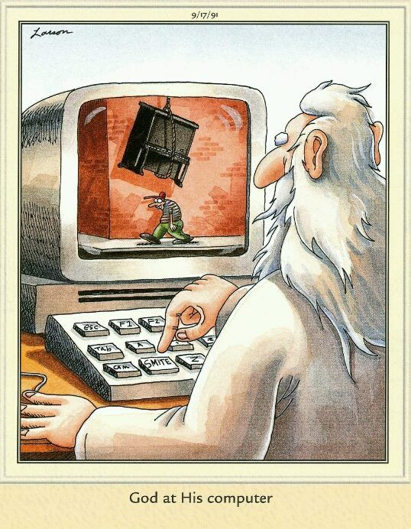

Slide 2
Six Days of Creation
Day 1 - The creation of light and the division of the light from the dark. (1:5)
Day 2 – The division of water from earth, and earth from the atmosphere. (1:8) (heaven) This is most likely not the atmosphere as we now know it.
Day 3 – Creation of plant-life on the earth. (1:13)
Day 4 – Creation of stars, planets, moons, etc. (1:19)
Day 5 – Creation of fish (water-dwellers) and fowl (flying things). (1:23)
Day 6 – Creation of mankind and everything that moves on the earth. (1:31)
Day 7 –God rested. Creation was completed, the work was finished. (2:2-3)
In Genesis 1, the termination of each day’s work is noted by the formula:
“And the evening and the morning were the first (or second, etc.) day.”
In other words, each day is bounded in a series of days. “Yom” followed by a cardinal number. Each day is a literal 24-hour period.

Slide 3
Things God Cannot Do
God cannot lie. “God is not a man, that He should lie.” (Numbers 23:19)
God cannot sin. “A God of faithfulness and without iniquity, just and upright is he.” (Deuteronomy 32:4)
God cannot deny Himself. “If we are faithless, he remains faithful—for he cannot deny himself.” (2 Timothy 2:13)
God cannot act contrary to His nature. “Every good gift and every perfect gift is from above, coming down from the Father of lights, with whom there is no variation or shadow due to change.” (James 1:17)

Slide 4
The Result of God’s Omnipotence
1. All nature is absolutely subject to His will and Word (Job 42:2)
2. All men are absolutely subject to His authority (James 4:12-15, Philippians 2:10-11)
3. All angels recognize His power (Daniel 4:25, Hebrews 1:13-14)
4. All Satanic hosts bow to His almightiness (Job 1:2, 2:6)

Slide 5
God is Omnipotent. So what?
Be renewed in your mind. Challenge yourself to reflect on the account given in Genesis. (Genesis 1:1-27, John 14:15-17)
Be ready to defend God’s truth against attacks that come in your own mind and from outside. (Proverbs 4:20-27, Philippians 4:8)
Be respectful and fearful of the Lord’s incomprehensible power and authority. (Proverbs 9:10, James 1:22-25)

