Slide 1
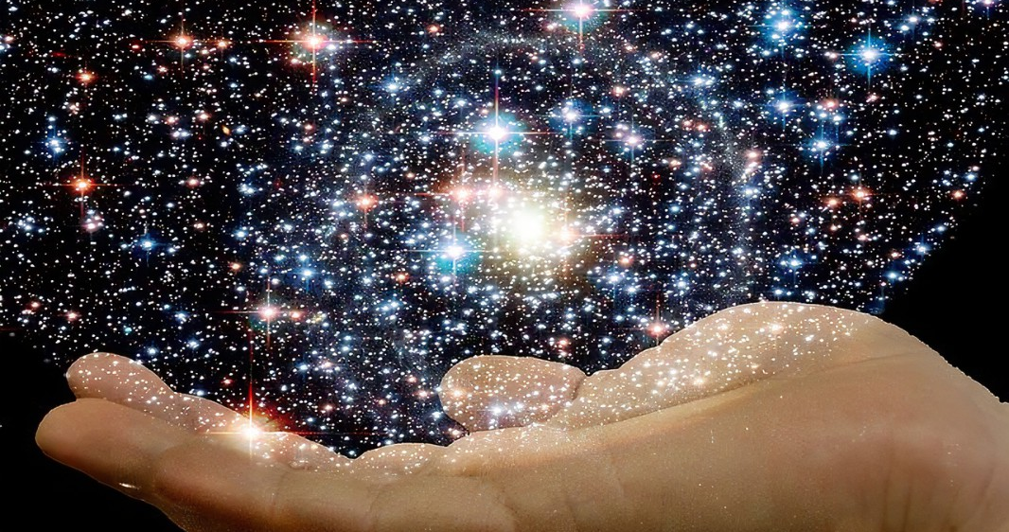

Slide 2
Romans 11:33
“Oh, the depth of the riches both of the wisdom and knowledge of God! How unsearchable are His judgments and His ways past finding out!”

Slide 3
Ephesians 1:11
“In Him also we have obtained an inheritance, being predestined according to the purpose of Him who works all things according to the counsel of His will…”

Slide 4
Psalm 147:5
“Great is our Lord, and mighty in power; His understanding is infinite.”

Slide 5
Proverbs 16:33
“The lot is cast into the lap, But its every decision is from the Lord.”
“You throw the dice, but the Lord determines how they come up.”

Slide 6
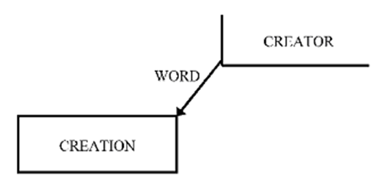

Slide 7
Matthew 11:20-23
“Then He began to rebuke the cities in which most of His mighty works had been done, because they did not repent: ²¹ “Woe to you, Chorazin! Woe to you, Bethsaida! For if the mighty works which were done in you had been done in Tyre and Sidon, they would have repented long ago in sackcloth and ashes. ²² But I say to you, it will be more tolerable for Tyre and Sidon in the day of judgment than for you. ²³ And you, Capernaum, who are exalted to heaven, will be brought down to Hades; for if the mighty works which were done in you had been done in Sodom, it would have remained until this day.”

Slide 8
Hebrews 4:13
“…there is no creature hidden from His sight, but all things are naked and open to the eyes of Him to whom we must give account.”

Slide 9
Psalm 139:1-6
“O Lord, You have searched me and known me. You know my sitting down and my rising up; You understand my thought afar off. You comprehend my path and my lying down And are acquainted with all my ways. For there is not a word on my tongue, But behold, O Lord, You know it altogether. You have hedged me behind and before And laid Your hand upon me. Such knowledge is too wonderful for me; It is high, I cannot attain it.”

Slide 10
3 Causes of Sin
We don’t know who God IS.
We are unconvinced of His Knowledge, Power, and Presence.
We don’t care about God’s authority over us.

Slide 11
Jeremiah 1:5
“Before I formed you in the womb I knew you; Before you were born I sanctified you; I ordained you a prophet to the nations.”

Slide 12
Psalm 139:16
“Your eyes saw my substance, being yet unformed. And in Your book they all were written, The days fashioned for me, When as yet there were none of them.”

Slide 13
Ephesians 2:4-8
“But God, who is rich in mercy, because of His great love with which He loved us, ⁵ even when we were dead in trespasses, made us alive together with Christ (by grace you have been saved), ⁶ and raised us up together, and made us sit together in the heavenly places in Christ Jesus, ⁷ that in the ages to come He might show the exceeding riches of His grace in His kindness toward us in Christ Jesus. ⁸ For by grace you have been saved through faith, and that not of yourselves; it is the gift of God…”

Slide 14
Application:
We are accountable to Him – Hebrews 4:13
Live your life openly – Numbers 32:23
Whom shall you fear? – Psalm 27:1-3

